Slide 1

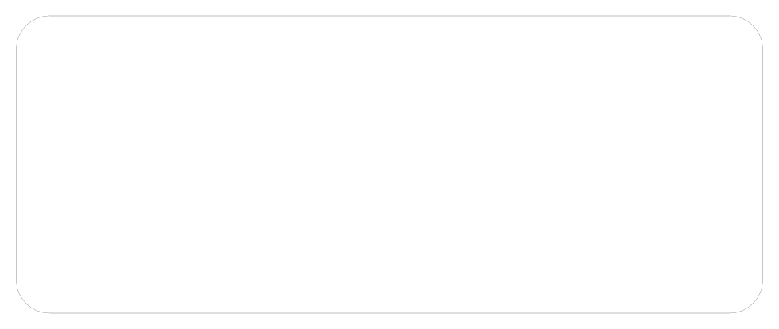
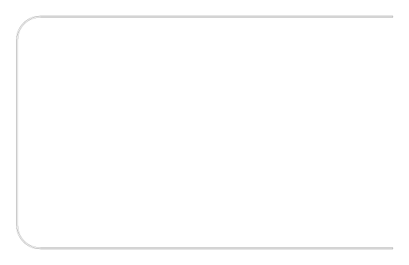
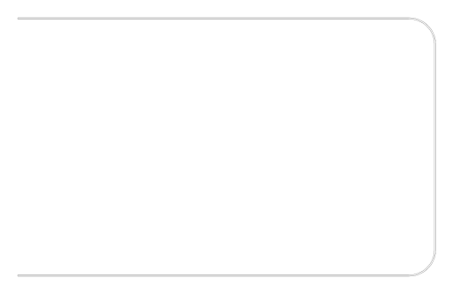
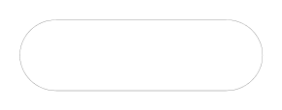
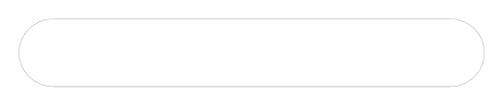
UETNOWSHERA | ELECTRICAL ENGINEERING
LAB REPORT 07
ONE-DIMENSIONAL ARRAYS IN C++
COURSE:
Computer Programming
AUTHOR:
Tahseen ullah
ROLL NO:
BF25NWELE0735
1.
OBJECTIVE
•To understand what an array is and why it is used in C++.
•To learn how to declare and initialize one-dimensional arrays.
•To access, read, and modify individual array elements using index notation.
•To copy elements fromone array to another using a loop.
•To work with character arrays and understand how individual characters are stored and accessed.
2.
THEORETICAL BACKGROUND
What is an Array? An array is a data structure in C++ that stores a fixed-size sequential collection of
elements all of the same type. Rather than declaring a separate variable for each value, an array
groups multiple values under a single name and allows each value to

Slide 2
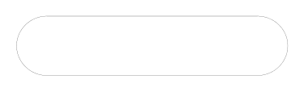
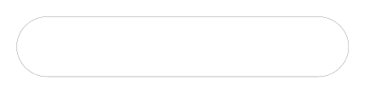
be accessed by its numeric index. All array elements occupy contiguous memory locations, with the
lowest address corresponding to the first element.
Declaration & Initialization. An array is declared by specifying the data type, a name, and the number
of elements in square brackets, such as int age[4];. An array can be initialized at the time of
declaration by providing a comma-separated list of values enclosed in curly braces. Alternatively,
individual elements can be assigned values after declaration using index notation.
Accessing & Copying Array Elements. Individual elements are accessed using the array name
followed by the index in square brackets. Array indices in C++ begin at 0, so the first element is at
index 0 and the last element of an array of size n is at index n-1. C++ does not provide a single
statement to copy an entire array. Each element must be copied individually using a loop, iterating
through every index to assign each source element to the corresponding position in the destination
array.
Character Arrays. A character array stores a sequence of characters, and in C++, a word can be
represented as a character array where each element holds one character. Individual characters can
be accessed and printed using the same index notation as any other array.
3.
SOFTWARE USED
•IDE: DEV-C++ IDE
•Compiler: C++ Compiler (bundled with DEV-C++)
4.
EXPERIMENTAL TASKS
Task 1: Array Declaration and Initialization
An integer array named numbers of size 5 was declared and initialized with the values 10, 20, 30, 40,
and 50. A for loop was then used to iterate through the array and display each element along with its
index. The implementation is as follows:

Slide 3
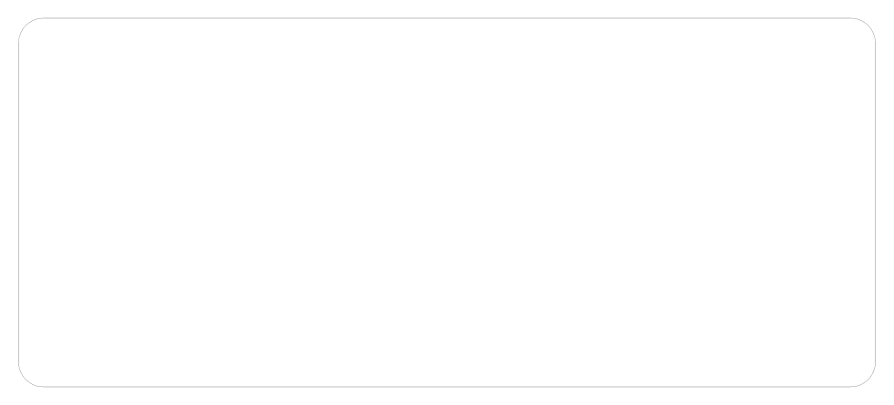
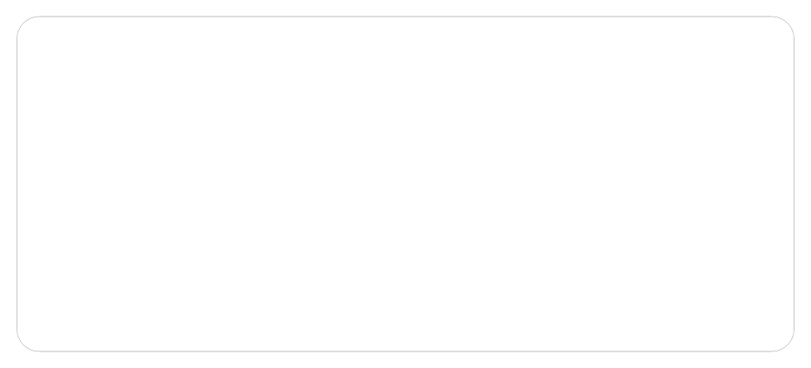
#include
"str"><iostream>
using
namespace std;
int main() {
// declare and initialise a 5-element integer array
int
numbers[5] = {10, 20, 30, 40, 50};
// display each element using its index
for ( int
i = 0; i < 5; i++) {
endl ;
}
cout <<
"numbers["
<< i <<
"] = "
<< numbers[i] <<
}
return
0;
Task 2: Accessing Character Array Elements
A character array named message was declared and initialized with the word 'POWER'. A for loop
was used to access each character of the array one by one and print it on a
separate line, demonstrating individual element access in a character array. The implementation is
as follows:
#include
"str"><iostream>
using
namespace std;
int main() {
char message[] =
"POWER";
// character array storing a word
int
len = 5;
// number of characters to display
// print each character on its own line
for ( int
i = 0; i < len; i++) {
endl ;
}
cout << message[i] <<
}
return
0;
Task 3: Copying Arrays
Two integer arrays, source and destination, each of size 5, were declared. The source array was
initialized with five values. A for loop was used to copy each element of source into the
corresponding position in destination. Both arrays were then displayed to verify the copy operation.
The implementation is as follows:

Slide 4
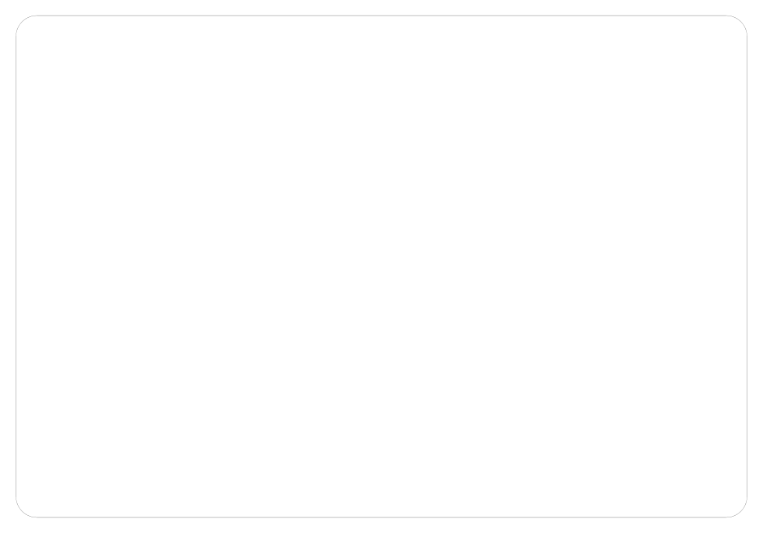
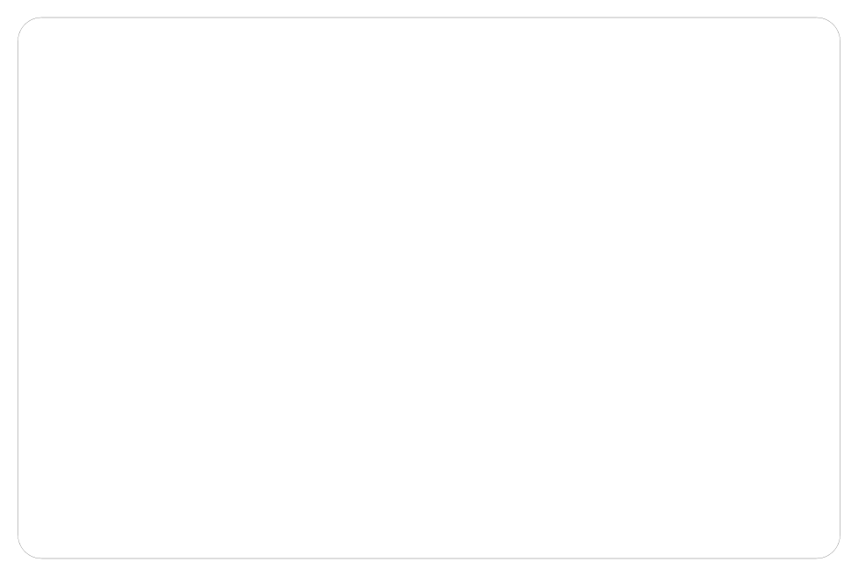
#include
"str"><iostream>
using
namespace std;
int main() {
source[5] = {5, 10, 15, 20, 25};
// values to copy
int
destination[5];
int
// receives copied values
// copy each element one by one
for ( int
i = 0; i < 5; i++) {
}
destination[i] = source[i];
cout <<
"Source: "
;
for ( int
i = 0; i < 5; i++)
cout << source[i] <<
" "
;
cout <<
endl ;
cout <<
"Destination: "
;
cout << destination[i] <<
for ( int
i = 0; i < 5; i++)
" "
;
cout <<
endl ;
}
return
0;
Task 4: Array Sum
This programprompts the user to enter 5 integers one at a time. Each value is stored in an integer
array. After all values have been entered, a second for loop computes the total sumof all elements
and displays the result. The implementation is as follows:
#include
"str"><iostream>
using
namespace std;
int main() {
nums[5];
int
int
sum = 0;
// read 5 integers into the array from the user
for ( int
i = 0; i < 5; i++) {
cout <<
"Enter number "
<< i+1 <<
": "
;
}
cin >> nums[i];
// accumulate the sum of all elements
for ( int
i = 0; i < 5; i++) {
}
sum += nums[i];
cout <<
0;
"Sum = "
<< sum <<
endl ;
}
return

Slide 5
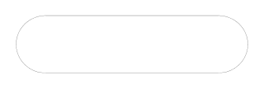
5.
CONCLUSION
This lab introduced one-dimensional arrays in C++, covering declaration, initialization, element
access, array copying, and character arrays. Arrays were shown to be an efficient way to manage
collections of related values under a single variable name. Loop structures were used throughout to
traverse and process array elements, reinforcing the close relationship between arrays and iteration.
These fundamentals formthe foundation for working with more advanced data structures
encountered in later stages of the course.

